Slide 1
An Introduction to SPSS
Md. Shahbaz Alam
Email: salam6@isrt.ac.bd

Slide 2
Session Outline
Introduction
Getting Started with SPSS
Data Management
Basic Analysis
Hypothesis Testing

Slide 3
Introduction

Slide 4
About SPSS
SPSS stands for Statistical Package for Social Science.
A software package that is used for statistical analysis.
Developed by Norman H. Nie, Dale H. Bent, and C. Hadlai Hull and released its first version in 1968.
Long produced by SPSS Inc., it was acquired by IBM in 2009. The current versions (2014) are officially named IBM SPSS Statistics.
It is used by market researchers, health researchers, survey companies, government, education researchers, marketing organizations, data miners, and others.
Want to know more! Visit: http://www.spss.com.hk/corpinfo/history.htm

Slide 5
OVERVIEW OF SPSS FILE EXTENSIONS
SPSS data file: .sav, example: my_data.sav
SPSS syntax file: .sps, example: my_syntax.sps
SPSS output file: .spv, example: my_output.spv
SPSS commands and variable names are NOT case sensitive.

Slide 6
RULES FOR VARIABLE NAMING
The name must begin with a letter. The remaining characters can be any letter, any digit, a period, or the symbols @, #, _, or $.
Blanks and special characters (for example, !, ?, ‘, and *) cannot be used.
Reserved keywords cannot be used as variable names.
Reserved keywords are: ALL, AND, BY, EQ, GE, GT, LE, LT, NE, NOT, OR, TO, WITH.
Variable names cannot end with a period (.) since the period may be interpreted as a command terminator.
Variable names should not contain more than 64 characters.

Slide 7
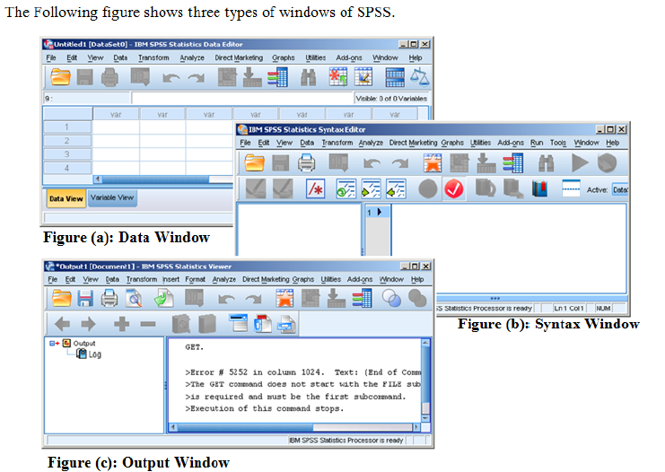
SPSS Windows

Slide 8
Getting Started with SPSS

Slide 9
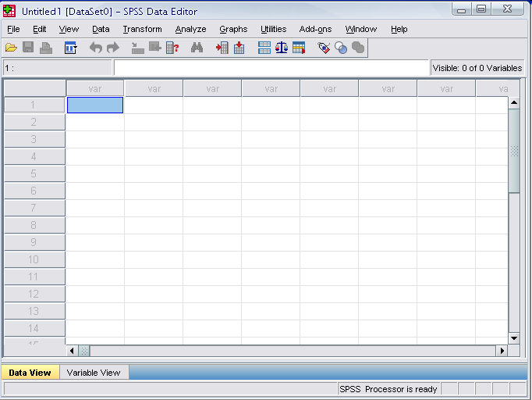
Opening SPSS
The default window will have the data editor
There are two sheets in the window:
1. Data view 2. Variable view

Slide 10
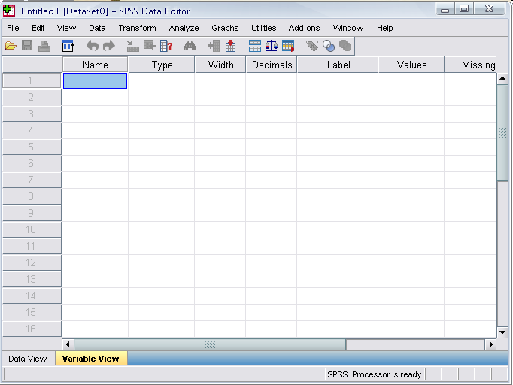
Data View window
The Data View window
This sheet is visible when you first open the Data Editor and this sheet contains the data
Click on the tab labeled Variable View

Slide 11
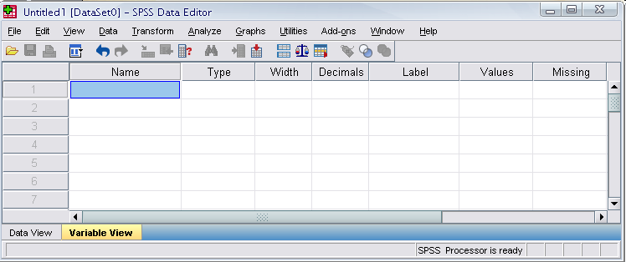
Variable View window
This sheet contains information about the data set that is stored with the dataset
Name
The first character of the variable name must be alphabetic
Variable names must be unique, and have to be less than 64 characters.
Spaces are NOT allowed.

Slide 12
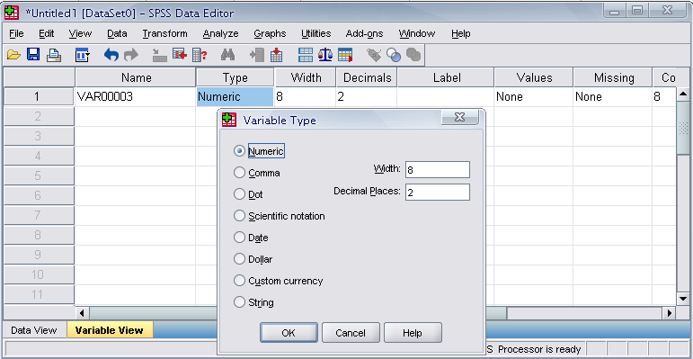
Variable View window
Type
Click on the ‘type’ box. The two basic types of variables that we will use are numeric and string. This column enables us to specify the type of variable.

Slide 13
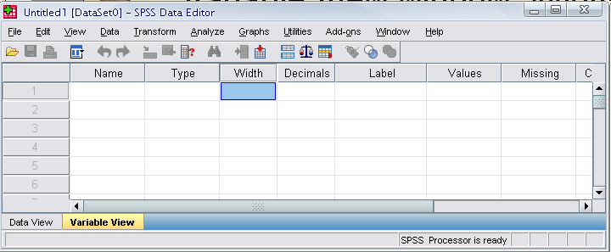
Variable View window
Width
Width allows us to determine the number of characters SPSS will allow to be entered for the variable

Slide 14
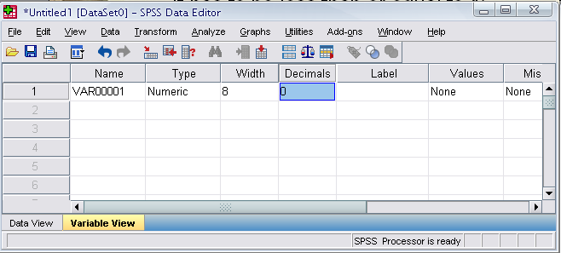
Variable View window
Decimals
Number of decimals
It has to be less than or equal to 16

Slide 15
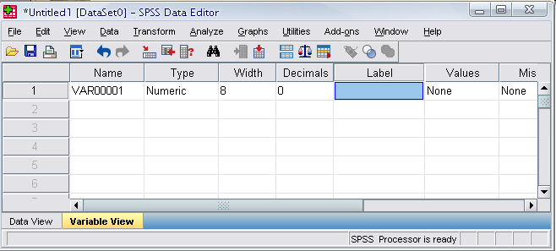
Variable View window
Label
You can specify the details of the variable
You can write characters with spaces up to 256 characters

Slide 16
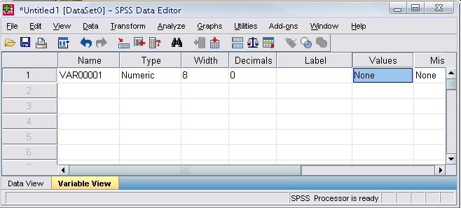
Variable View window
Values
This is used and to suggest which numbers represent which categories when the variable represents a category

Slide 17
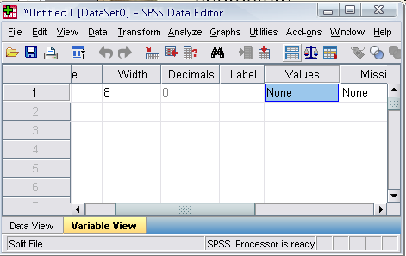
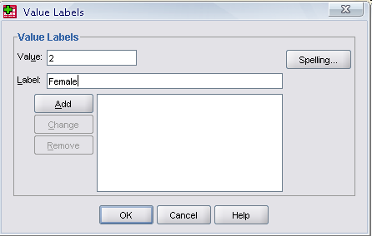
Defining the value labels
Click the cell in the values column as shown below
For the value, and the label, you can put up to 60 characters.
After defining the values click add and then click OK.

Slide 18
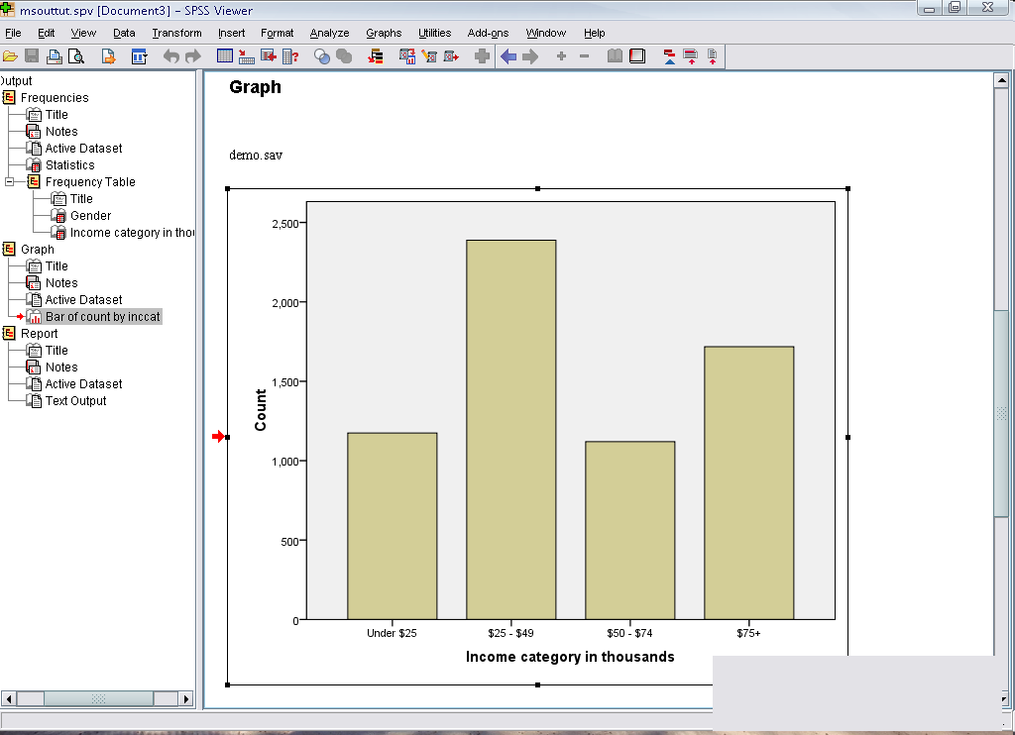
Output Viewer
Displays output and errors. Extension of the saved file will be “.spv”

Slide 19
Practice 1
How would you put the following information into SPSS?
Name | Gender | Height
A | male | 5.7
B | female | 5.4
C | female | 5.3
D | male | 5.6
E | male | 5.8
F | male | 5.7
G | female | 5.5
H | female | 5.5
I | female | 5.6
J | male | 6

Slide 20
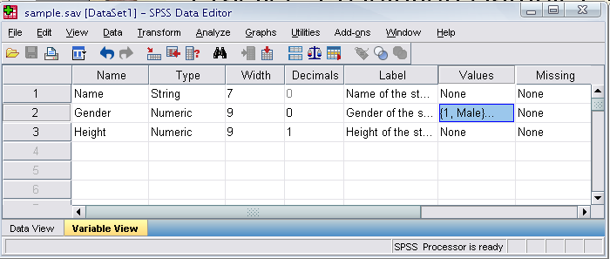
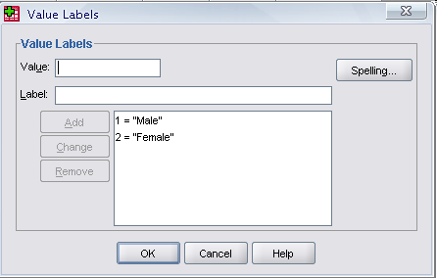
Practice 1 (Solution Sample)
Click

Slide 21
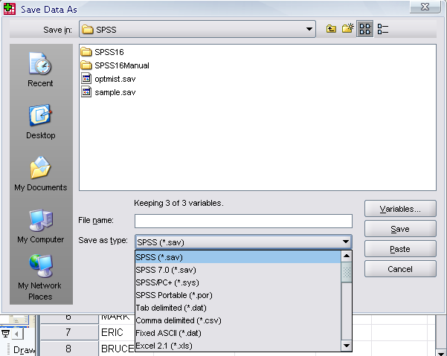
Saving the data
To save the data file you created simply click ‘file’ and click ‘save as.’ You can save the file in different forms by clicking “Save as type.”

Slide 22
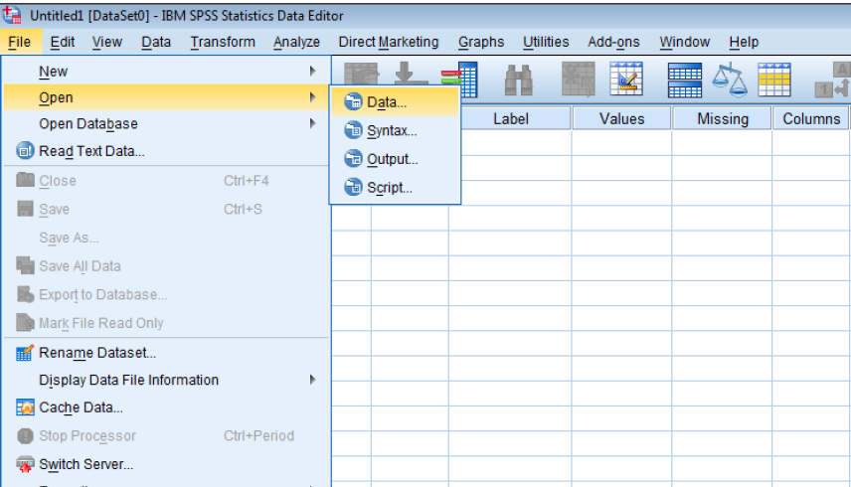
OPENING DATA, SYNTAXES AND OUTPUTS IN SPSS

Slide 23
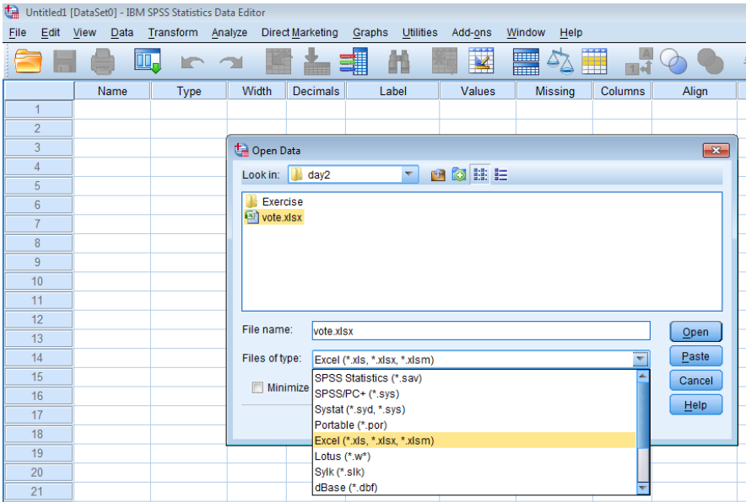
IMPORTING EXCEL DATA FILES INTO SPSS

Slide 24
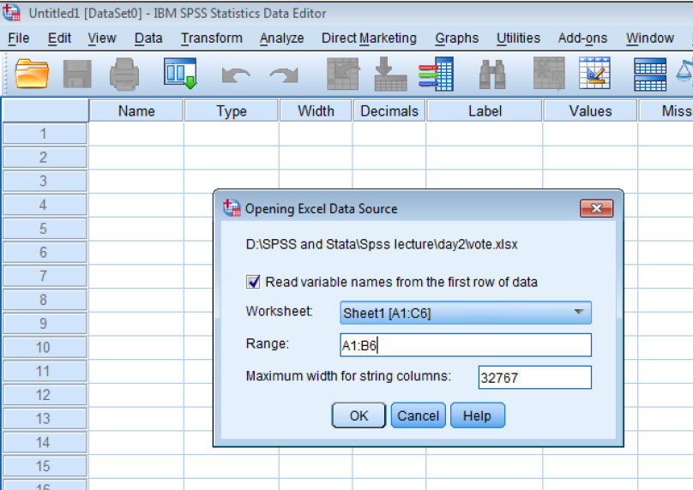
IMPORTING EXCEL DATA FILES INTO SPSS

Slide 25
ARITHMETIC, RELATIONAL AND LOGICAL OPERATORS
Arithmetic operator | Addition (+), Subtraction (-), Multiplication (*), Division (/), Exponentiation (**).
Relational operator | Equal to (EQ or =), Not equal to (NE or ∼=), Less than (LT or <), Less than or equal to (LE or <=), Greater than (GT or >), Greater than or equal to (GE or >=).
Logical operator | AND and OR.
Missing value function | MISSING(arg), SYSMIS(arg)

Slide 26
Data Management

Slide 27
SUB-SETTING DATA: SELECT IF AND SAMPLE
SELECT IF permanently selects cases for analysis based upon logical conditions found in the data.
From the menu:
click “Data”
Click “Select Cases”
click “if condition is satisfied”
Set if condition and press “Continue”
Choose ”Delete unselected cases” and press “OK”
We can also randomly select sample from currently working data

Slide 28
SORTING CASES: SORT CASES COMMAND
SORT CASES re-orders the sequence of cases in the working data file based on the values of one or more variables. Cases can be sorted by ascending or descending order. For example,
From the menu:
Data
Sort Cases
Choose variable on which to sort
Choose “Ascending” or “Descending”
Press “OK”

Slide 29
TRANSFORMING A VARIABLE: RECODE COMMAND
Recode into different variable:
”Transform” ->”Recode into Same Variables. . . ”
Recode into same variable:
”Transform” ->”Recode into Different Variables. . . ”

Slide 30
TRANSFORMING A VARIABLE: COMPUTE COMMAND
General form: COMPUTE target variable = expression
Compute salary increment:
SALARY-SALBEGIN
Compute % of increment:
PINCREM=(INCREMENT/SALBEGIN) * 100.
Then compute salary increase for the next year:
RAISE = SALARY * 0.12.

Slide 31
TRANSFORMING A VARIABLE: COMPUTE COMMAND
From the menu:
Go to “Compute Variable” from “Transform” menu
Name “Target Variable”
Set “Numeric Expression”
Follow steps and finally press “OK”

Slide 32
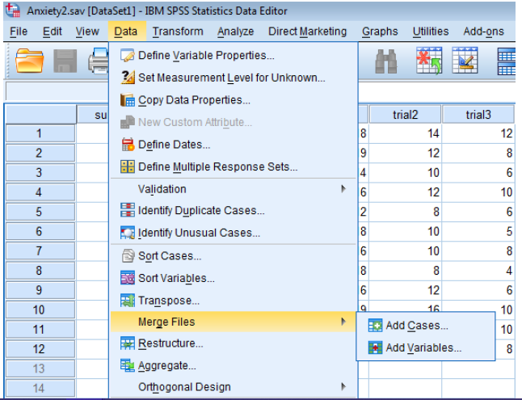
APPENDING AND MERGING SPSS DATA FILES
Append: Adding additional observations to an existing data set.
Merge: Adding additional variables to an existing data set. Need to sort the common variable(in both dataset) first.

Slide 33
Basic Analysis

Slide 34
Some Basic Analysis in SPSS
Frequencies
Produces frequency tables that shows frequency counts and percentages of the values of individual variables.
Descriptives
This analysis shows the summary statistics( maximum, minimum, mean, standard deviation etc.) of the variables.
Linear regression analysis
Linear Regression estimates the coefficients of the linear equation

Slide 35
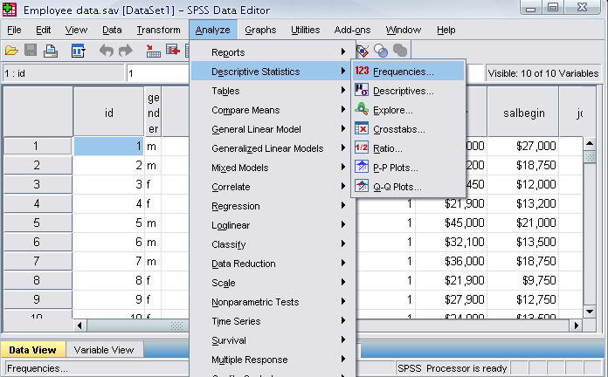
Frequencies
We want to draw a frequency table as well as a bar chart for ‘Gender’ variable
From the menu:
Click ‘Analyze’ , ‘Descriptive statistics,’ then click ‘Frequencies’

Slide 36
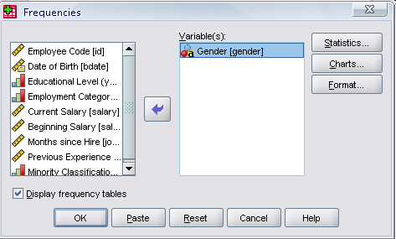
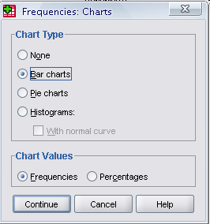
Frequencies
Click gender and put it into the variable box.
Click ‘Charts.’
Then click ‘Bar charts’ and click ‘Continue.’
Click

Slide 37
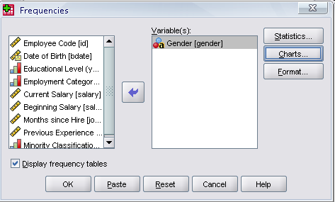
Frequencies
Finally Click OK in the Frequencies box.
Click

Slide 38
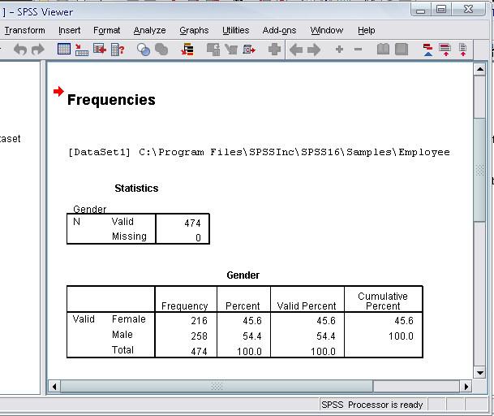
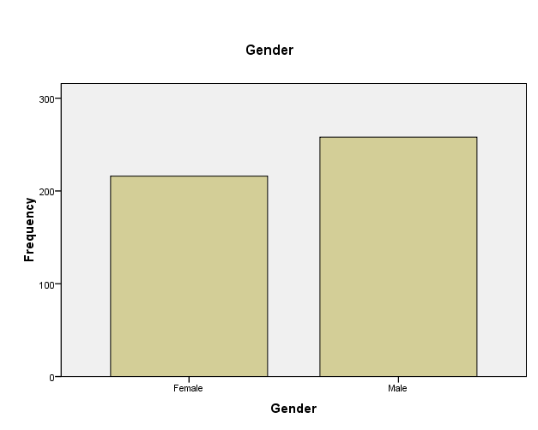
Output

Slide 39
Practice 2
Do a frequency analysis on the variable “minority”
Create a pie charts for it

Slide 40
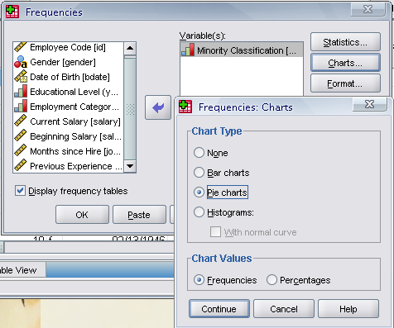
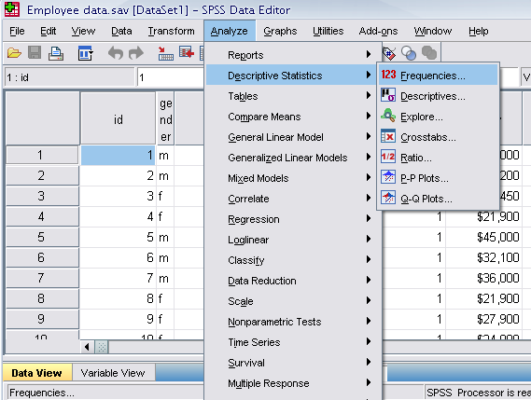
Answer

Slide 41
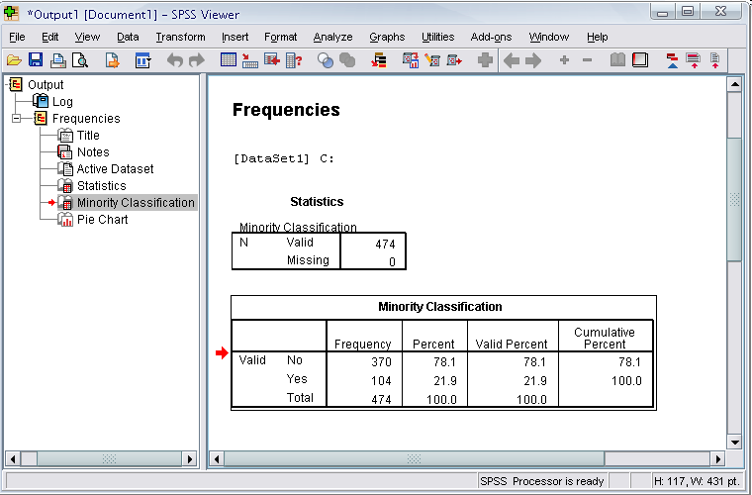
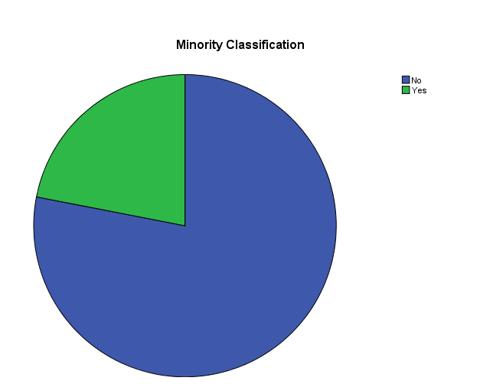
Answer

Slide 42
Practice 3
Draw a histogram for the variable ‘salary’
Also show a table that contains summary statistics like mean, median, minimum and maximum salary.

Slide 43
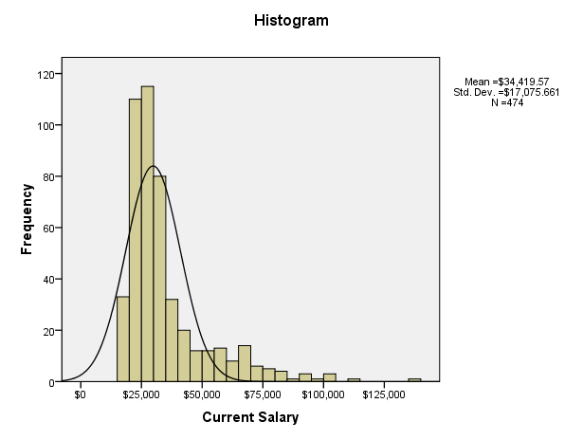
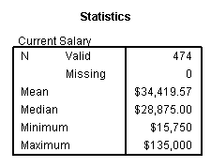
Answer

Slide 44
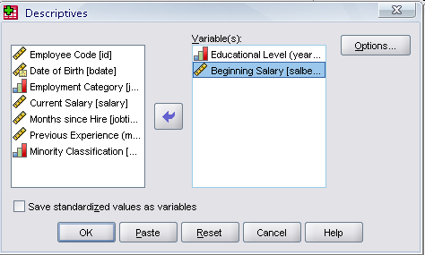
Descriptives
Click ‘Analyze,’ ‘Descriptive statistics,’ then click ‘Descriptives’
Click ‘Educational level’ and ‘Beginning Salary,’ and put it into the variable box.
Click Options
Click

Slide 45
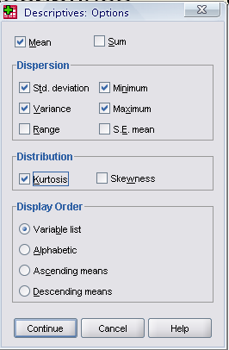
Descriptives
The options allows you to analyze other descriptive statistics besides the mean and Std.
Click ‘variance’ and ‘kurtosis’
Finally click ‘Continue’
Click
Click

Slide 46
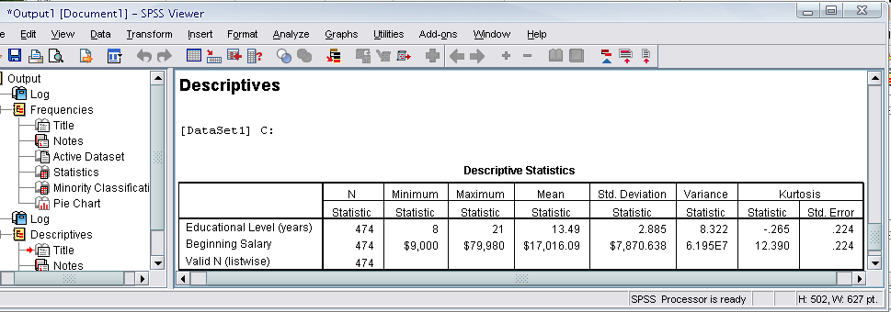
Descriptives
Finally Click OK in the Descriptives box. You will be able to see the result of the analysis.

Slide 47
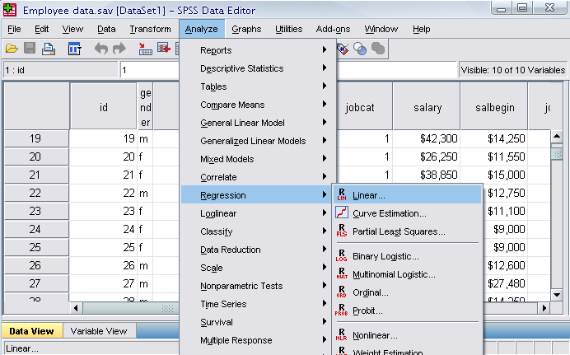
Regression Analysis
Click ‘Analyze,’ ‘Regression,’ then click ‘Linear’ from the main menu.

Slide 48
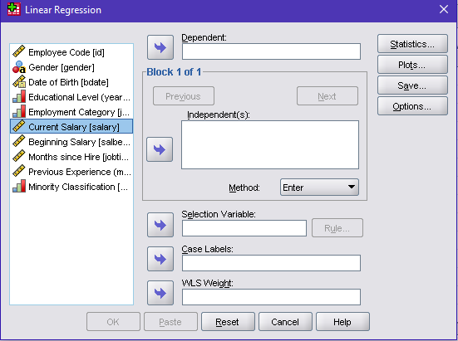
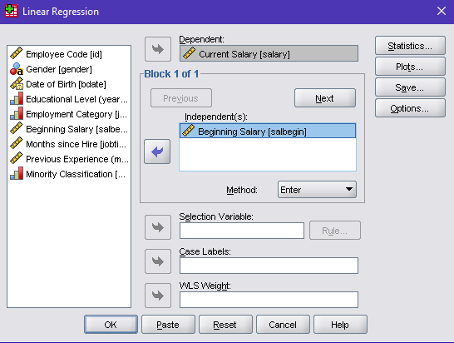
Regression Analysis
For example let’s analyze the model
Put ‘Current Salary’ as Dependent and ‘Previous Salary’ as Independent variable.
Click
Click

Slide 49
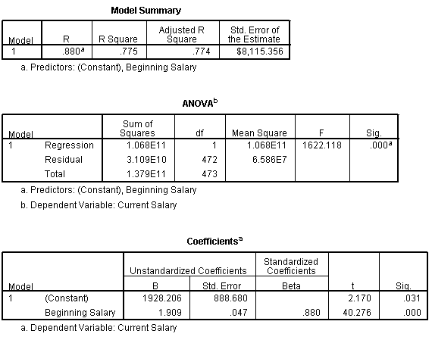
Regression Analysis
Clicking OK gives the result.

Slide 50
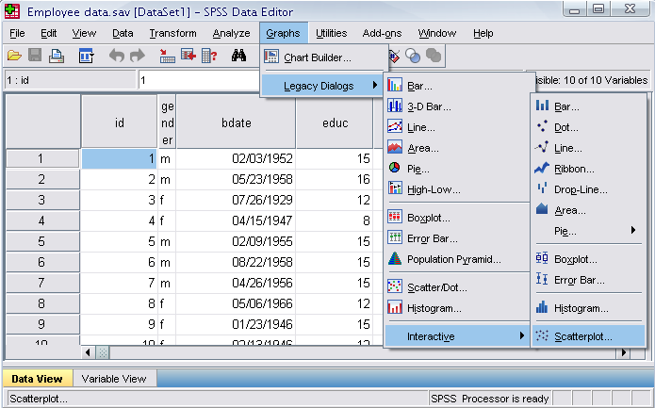
Plotting the Regression Line
Click ‘Graphs,’ ‘Legacy Dialogs,’ ‘Interactive,’ and ‘Scatterplot’ from the main menu.

Slide 51
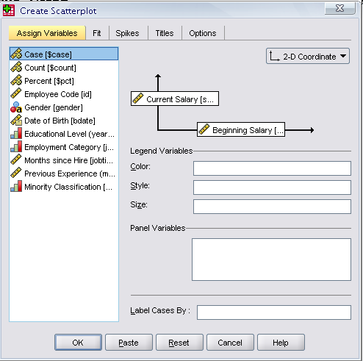
Plotting the Regression Line
Drag ‘Current Salary’ into the vertical axis box and ‘Beginning Salary’ in the horizontal axis box.
Click ‘Fit’ bar. Make sure the Method is regression in the Fit box. Then click ‘OK’.
Set this to
Regression!
Click

Slide 52
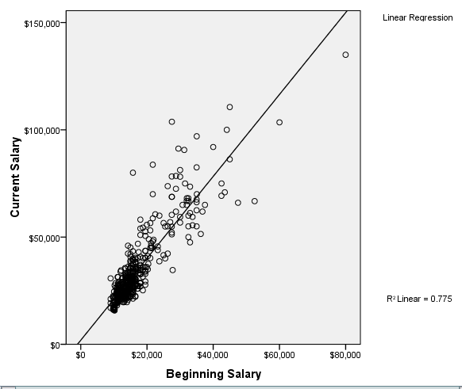
Output

Slide 53
Practice 4
Find out whether or not the previous experience of workers has any affect on their beginning salary?
Take the variable “salbegin,” and “prevexp” as dependent and independent variables respectively.
Plot the regression line for the above analysis using the “scatter plot” menu.

Slide 54
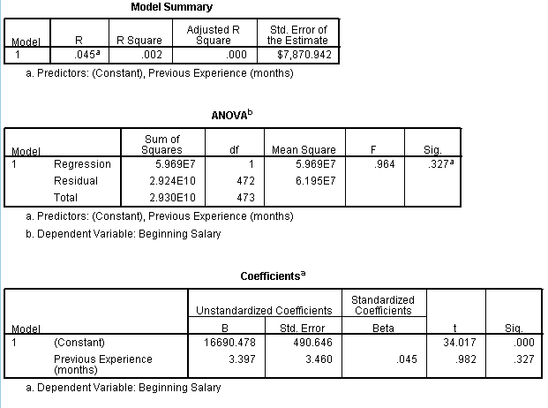
Output

Slide 55
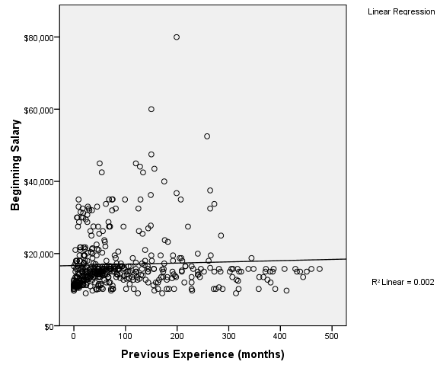
Output

Slide 56
Test of Hypothesis

Slide 57
Basics of Hypothesis Testing
Hypothesis Testing is a decision making process for evaluating claims about a population.

Slide 58
Basics of Hypothesis Testing
The researcher must
Define the population under study
State the hypothesis that is under investigation
Give the significance level
Select a sample from the population
Collect the data
Perform the statistical test
Reach a conclusion

Slide 59
Basics of Hypothesis Testing
How to set your hypotheses
Set the researcher’s hypothesis as alternative hypothesis.
When you are testing if a parameter differs from a certain value, set that particular value as the null value.
If you are testing a difference between two samples, set 0 as the null value.

Slide 60
Basics of Hypothesis Testing
Decisions are taken based on P-values.
P-value stands for probability value.
Definition of P-value
The probability of observing more extreme observations (or observing more extreme test statistics).

Slide 61
Basics of Hypothesis Testing
One-tailed test
e.g.
H₀: µ₁ = µ₂
H₁: µ₁ > µ₂
If the sample
statistic falls
in this region,
we would
not reject H₀.
We would reject H₀ if the sample statistic falls in these regions.

Slide 62
Basics of Hypothesis Testing
The area of the rejection region is α.
α is called the level of significance.
You reject your null hypothesis when the p-value is lower than α i.e. there is more chance of observing more extreme observations than those obtained from the sample.

Slide 63
One sample t-test (Test of Population Mean)
Suppose that we want to answer the question: Can you conclude that a certain population mean is not 50? The null hypothesis is
H₀: µ = 50
and the alternative hypothesis is
H₁: µ ≠ 50.

Slide 64
One sample t-test (Test of Population Mean)
For example, using the hsb2.sav data file, say we wish to test whether the average writing score (write) differs significantly from 50. We can do this as shown below.
Click ‘Analyze’, ‘compare means’ then click ‘one sample t-test’
Put the variable that we wish to test in the ‘Test Variable(s)’ box
Set the test value. (say 50)
Click ‘OK’

Slide 65
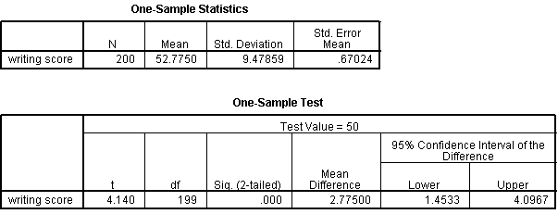
One sample t-test (Test of Population Mean)
Output:
In a similar way we can perform two sample t-test

Slide 66
Test of Association
Suppose we want to test if a categorical variable is associated with another categorical variable. We first make a contingency table and perform Chi- square test of association. We may state the hypothesis formally as follows:
H₀: No association
H₁: There is association

Slide 67
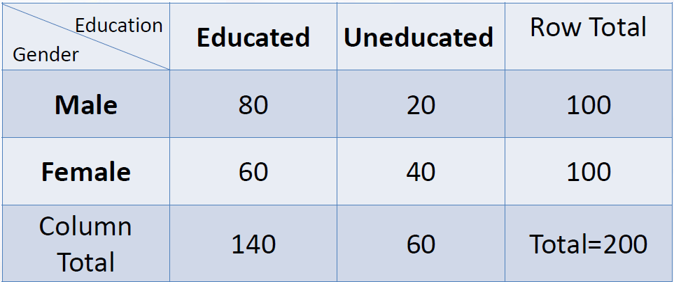
Test of Association

Slide 68
Test of Association
Using the hsb2.sav data file, let's see if there is a relationship between the type of school attended (schtyp) and students' gender (female). Remember that the chi-square test assumes that the expected value for each cell is five or higher. We can do this as follows:
Click ‘Analyze’, go to ‘Descriptive statistics’ and then click ‘crosstabs.’
Put Row and Column variable in the box then click ‘Statistics’. Select Chi-square, then click ‘continue’, then ‘ok’

Slide 69
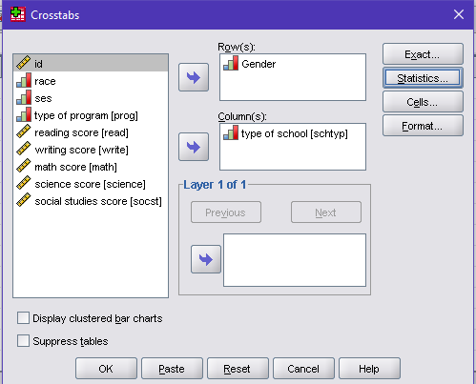
Test of Association

Slide 70
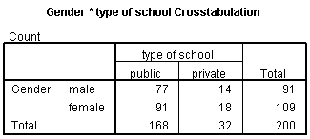
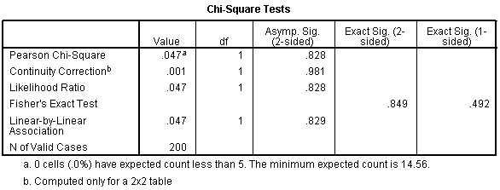
Test of Association
Output:
Decision: These results indicate that there is no statistically significant relationship between the type of school attended and gender.

Slide 71

Thank you for your patience!

